Slide 1
Are PB4L schools inclusive schools?
Confident educators; confident parents, families, whānau and communities and confident learners.

Slide 2
Mā te huruhuru te manu karere
With feathers a bird flies

Slide 3
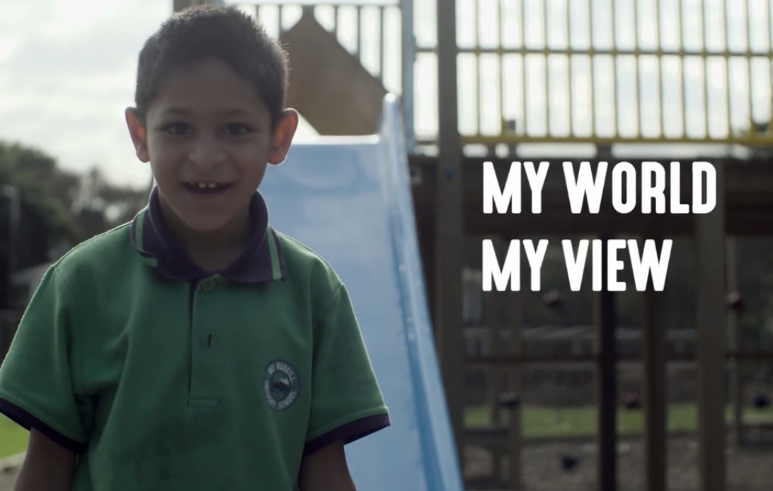
https://vimeo.com/169767226
Notes:
Because the theme of this conference is student voice, we’ll start today with the voice of what we think are some very wise students.
The New Zealand Disability Strategy is currently being reviewed. As part of our input into this review, we asked some students about their views on disability and inclusion in Aotearoa. This is what they had to say.

Slide 4
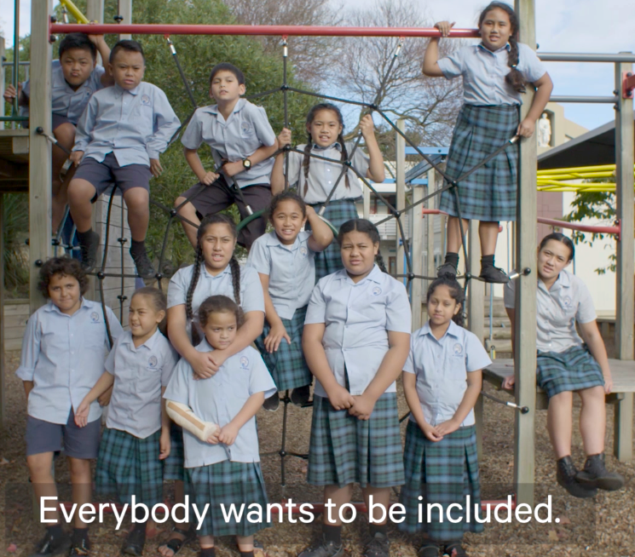
Outline for today
Respect
Hear our voices
Care about our learning
Notes:
Our students have made it very clear to us what matters to them. And today we’ll unpack three themes that they tell us are important for them to be included and succeed: Respect, hearing their voices and caring about their learning.
All of the things we talk about today are supported by resources that we’ve produced over the last 24 months to support inclusive practices in schools:
Catalogue
Inclusive education website
Inclusive practice and the school curriculum website
Videos
Booklets
Student voice tools
All of the five activities we hope to get through today, you can replicate and do in a one hour staff meeting.
For those of you who have been to one of our inclusive education workshops before, the vast majority of today’s session will be new information that you can add to your repertoire, as well as some revision.
We use the word resources and not resourcing. We are not involved in the policy or decision-making around funding and resourcing.
Whatever is going on in the funding space, we’re confident that the resources will support good, effective, flexible teaching practices for all your students and add value to the work you’re already doing.
The resources have been produced for the English medium space. Having said that, we’ve worked hard to weave universal voice through the resources. We’ve also taken care to align with some of the elements Effective Teaching Profile in Te Kotahitanga, in particular Manaakitanga, Mana Motuhake and Ako.

Slide 5
Success for ALL (students, staff, settings)
students are engaged and achieving
students experience academic and social success
wellbeing
belonging
effective and flexible teaching
knowing your learner, student voice
leadership
strong values base
data driven and evidence-based
Is a PB4L school an inclusive school?
Notes:
We’ve identified a range of areas where PB4L School-Wide and inclusive education meet.
But does this mean that a PB4L school is automatically an inclusive school?
Throughout the session, we want you to consider: Do ALL our students get access to the same supports, learning and outcomes through PB4L?
By the end of the session, we hope you’ll have some practical ideas and perspectives that can be naturally woven into your PB4L journey to support both positive behaviour and positive learning outomes for all your students.

Slide 6
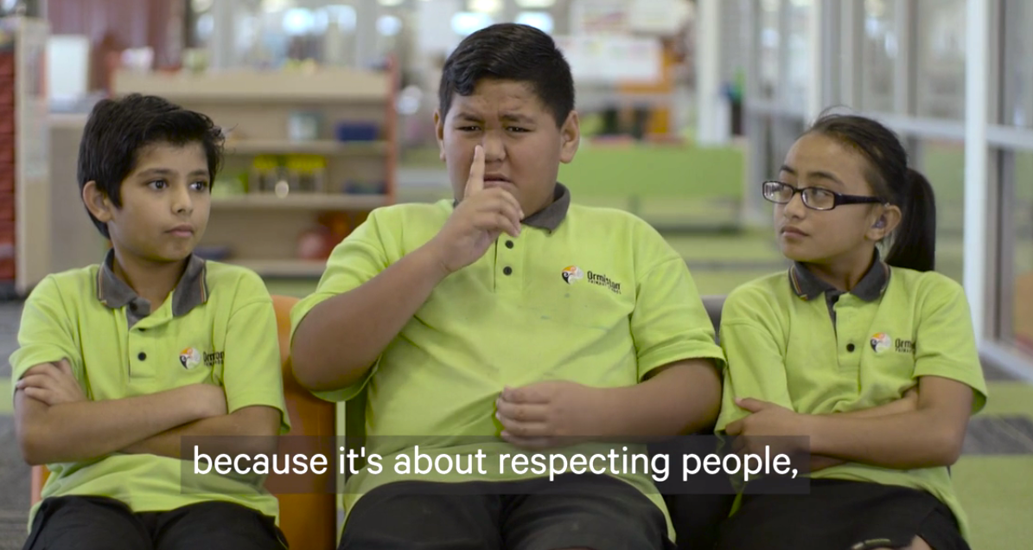
Theme: Respect
“Because it’s about respecting people. It’s about everybody being treated equally.”
Brooklyn
Notes:
The first theme our students tell us is important for them to be included and succeed is respect.
Activity:
On post-it notes write your school’s PB4L expectations. Place these on the sheet of paper alongside those of the others at our table and theme them.
Read the three inclusive values in the Success for All document: Valuing everyone, respect for diversity, equity for all.
Discuss and report back: Are inclusive values transparent in our school’s PB4L expectations? If not, what could we do to strengthen this aspect and highlight inclusion?

Slide 7
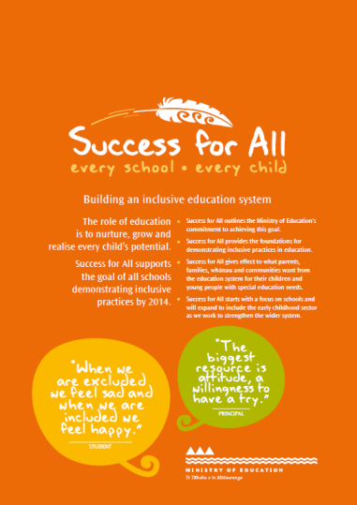
Activity:
On post-it notes, write down your school’s PB4L expectations.
Place these on a sheet of paper alongside others from your table.
Theme them.
Read the three inclusive values in the Success for All document (back page)
Discuss: Are inclusive values transparent in your school’s PB4L expectations? If not, what could you do to strengthen this aspect?

Slide 8
Is a PB4L school an inclusive school?
Yes!
No!
Maybe?
Depends...
Notes:
Given the discussions we’ve just had, show us a sign:
Do you think a PB4L school is automatically an inclusive school?

Slide 9
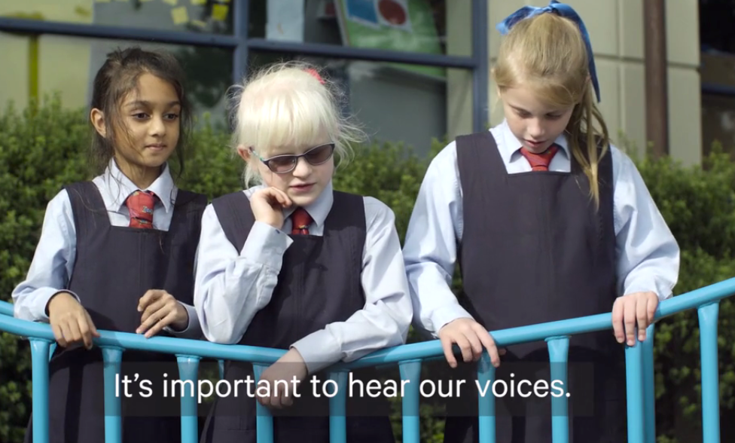
Theme: Hear our voices
“It’s important to hear our voices.”
Madeleine
Notes:
The second theme our students tell us is important for them to be included and succeed is hearing their voices.
We’ve developed a wide range of tools that can give you creative ways to inject student and whanau voice into your PB4L work, and we’ll take you through a few of these in the next half hour.

Slide 10
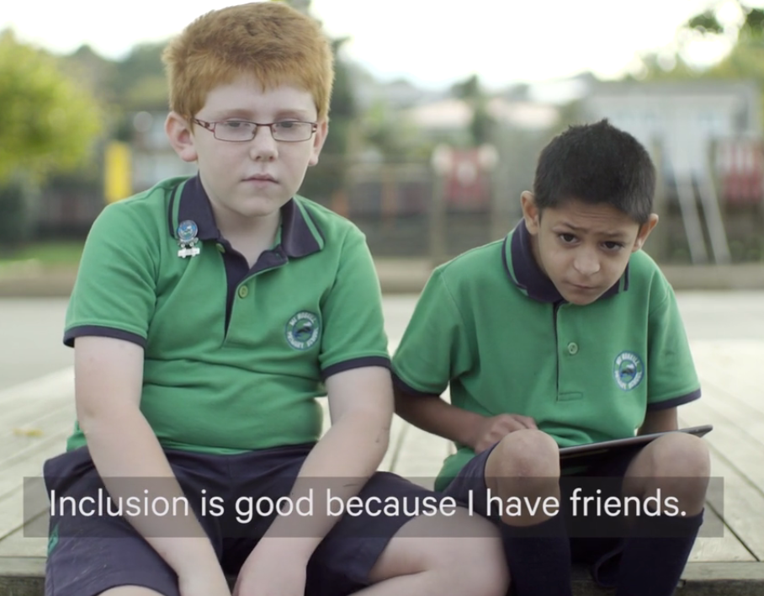
Students need to feel they belong
Student need for belonging to a community is one of the most powerful factors in school engagement.
Notes:
Professor Robert Blum who works as a consultant for UNICEF, the World Bank and the World Health Organisation has released some research looking at what young people need for healthy development. He says, “Attachment to school is a critical factor. Having a sense of belonging at school is a key protective factor for young people. Having good friends, believing that teachers are fair, knowing that you matter to someone at school – these are all associated with good outcomes for young people.”

Slide 11
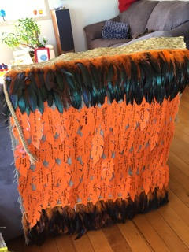
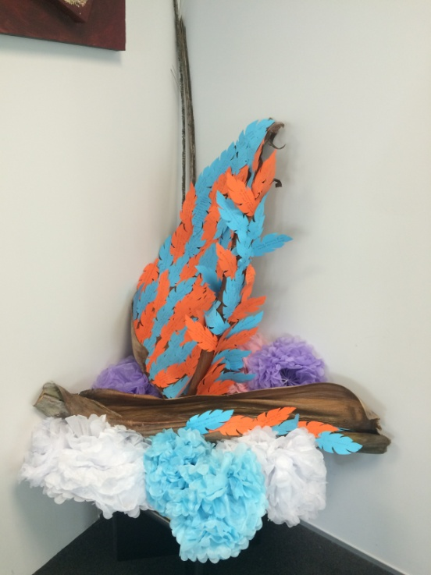
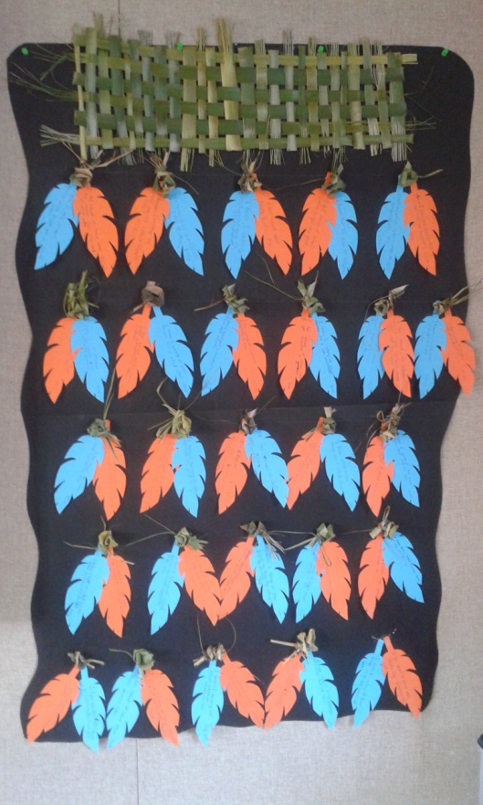
Notes:
We’ve asked students to talk about belonging in creating whatu pokeka. A whatu pokeka is a baby blanket that is lined with feathers. It protects and nurtures a child and changes shape as they grow. We asked students to complete two sentences for us: “I know I belong at school because…” and “I feel valued when…”
Read some of the feathers – having friends, being with friends, being able to be myself, being included, feeling unique and special, being heard, having a say, being listened to.
Refer to whatu pokeka activity card on their tables – can be ordered for free on Down the Back of the Chair.
Check if any schools present who have doen the activity – Massey High

Slide 12
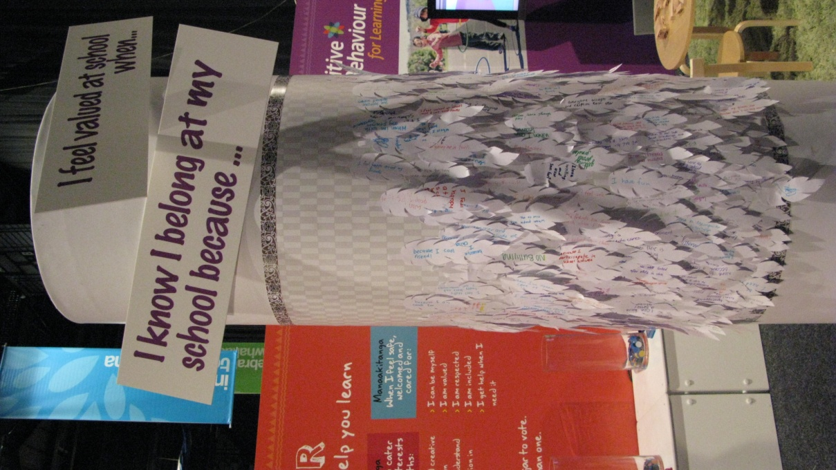
I know I belong because...
I feel valued when ...
Notes:
So we’re going to make our own whatu pokeka today. On your table are enough feathers for two each. On one feather finish the sentence, “I know I belong because” on the other, “I feel valued when”. This can be any context – home, school, work, community. Be polite, because we will gather the feathers up. Share your answers with others at your table. Put the feathers at the end of the table for us to gather up.
Examples from schools who have used the whatu pokeka exercise:
Family maths evening – school wanted to collect parent and student voice regarding a sense of belonging and feeling valued in maths. A whatu pokeka was made using the feathers and put onto a blanket. This was displayed in the school foyer for families to read and discuss. The teachers analysed the responses and set actions to support improving home/school links to strengthen supporting maths between home and school
PB4L – one school was holding its PB4L celebration day so got parents and students to complete statements and make a whatu pokeka.
Within a school each class made a whatu pokeka and teachers analysed the feathers to see if there were any trends and patterns acorss the school. In one year level it was noticed that students were very extrinsically motivated with statements like “I feel valued when my mum and dad give me something when I’ve done well at school,” and “ I feel valued when I get a sticker for doing my work”. Teachers were going to go back and do some teaching around the school values and focus on developing students’ intrinsic motivation.

Slide 13
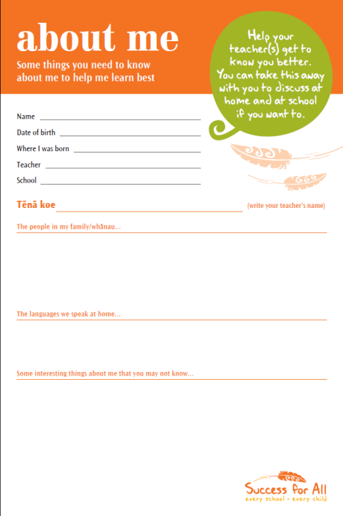
Student voice resources
Notes:
Refer to a range of other tools for student and whanau voice:
About Me learner profile
Family/whanau file
PB4L family and whanau checklists

Slide 14
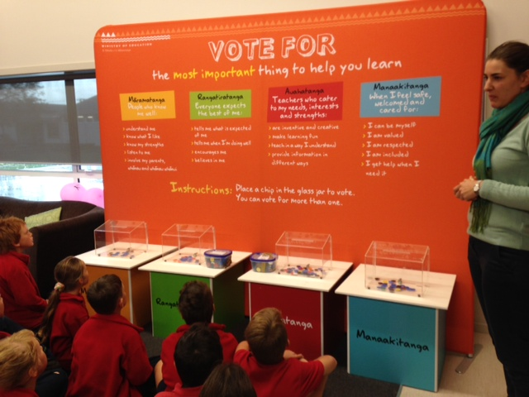
The most important things to help me learn… (Inclusion)
Notes:
The voting wall takes 4 elements of inclusive practices – read each one out.
Students from around the country have voted for the most important one for helping them learn. By far the most popular element has been Manaakitanga when I feel safe, welcomed and cared for. As the previous board chair of Pomaria School has said, “I don’t care what you know until I know that you care”.
Woodened school to talk about their findings from voting wall.
But it’s not enough to care – we also need to care for learning, say our students, who voted second for Auahatanga, my teacher caters to my needs, interests and strengths.
Interestingly, when we displayed this at the Ulearn conference two years ago and only teachers voted, they voted for Auahatanga first, closely followed by Manaakitanga. It’s not surprising that teachers are focused on auhatanga – is that not what they’re there for, to support learning? But they obviously recognise that their students are not motivated to learn if they are not cared for.
Some schools have used different coloured voting chips for teachers, parents and students. The results differ across these groups and schools have taken this data and discussed it with their communities to look at where the schools puts its efforts and what it prioritises for those groups.
You can order the voting wall for your school through the special education email mailbox – see your catalogue.

Slide 15
The most important things to help me learn… (PB4L)
Notes:
So how do these inclusive elements relate to PB4L?
Activity:
Watch the video of Ivan and Eli on what helps them to behave and learn
As you watch, write down what supports Eli and Ivan talk about that help their engagement and motivation

Slide 16
Notes:
Activity continued:
What elements from the voting wall do you see coming through and being reflected in Ivan and Eli’s changed experience of school?
Note that Ivan and Ely were not asked about inclusion – they were asked what teachers can do to help them learn and they asked for good inclsuive practices.

Slide 17
Is a PB4L school an inclusive school?
Yes!
No!
Maybe?
Depends...
Notes:
Given the discussions we’ve just had, show us a sign:
Do you think a PB4L school is automatically an inclusive school?

Slide 18
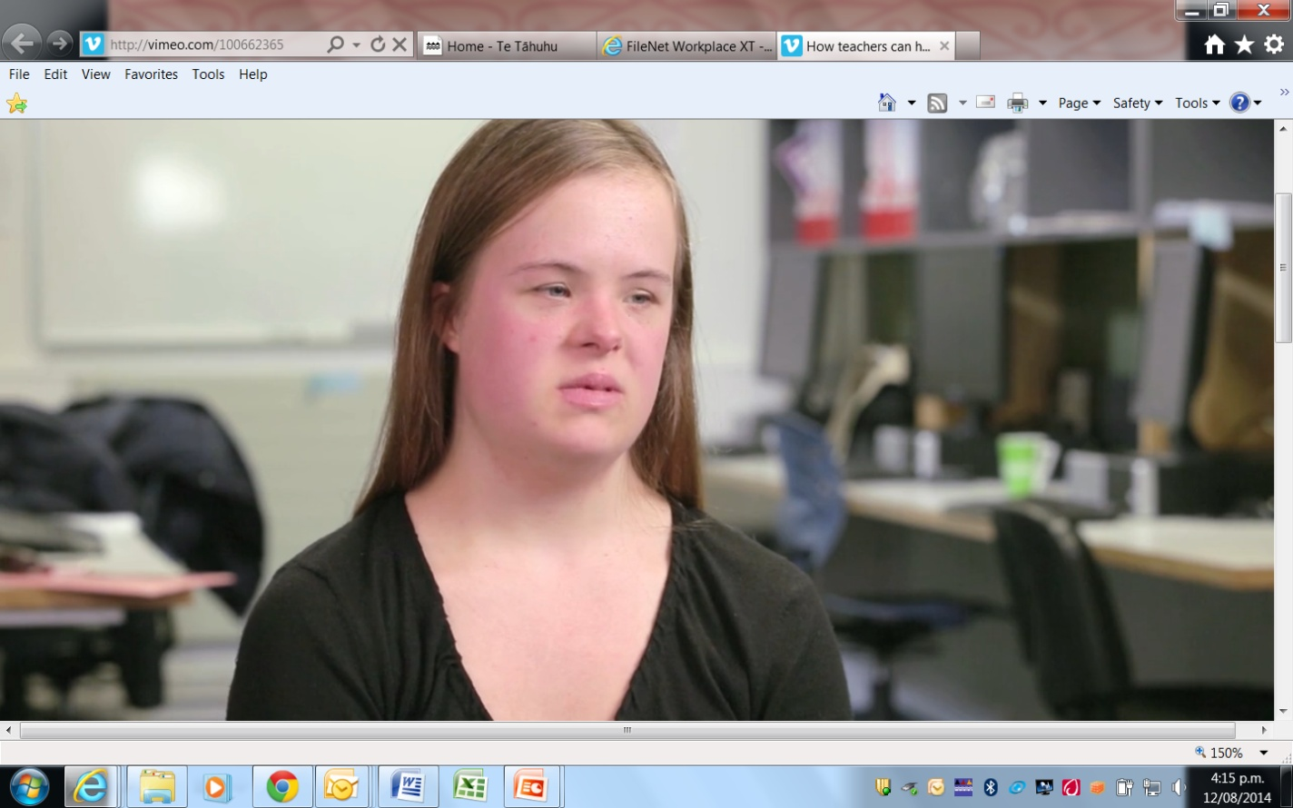
Theme: Care for our learning
✔ Write down all the things that Katrina asks for to help her learn
Katrina, What teachers can do to help me learn: https://vimeo.com/100662365
Notes:
Going back to the voting wall, students have voted most for Manaakitanga. But it’s not enough to care. Manaakitanga is closely followed by Auahatanga. And Eli and Ivan have made it clear that we need to care for learning.
So let’s hear from another student about how teachers can care for her learning.
As with Ivan and Eli, while we play this video, we want each of you to jot down the list of all the things Katrina suggests that would help her learn. Once you’ve seen the video you will be discussing these points at your table.

Slide 19
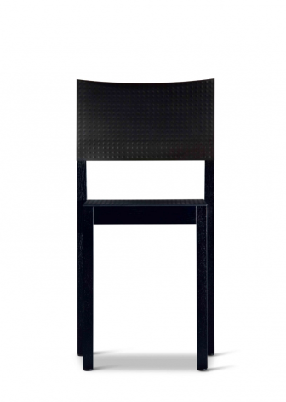
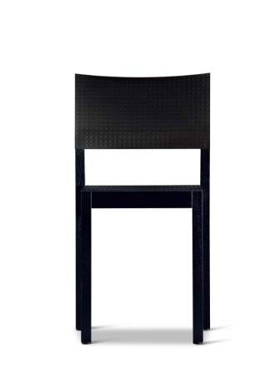
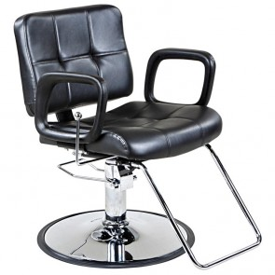
Notes:
Presenter note: This is a personal story that Judy shares. You might have your own illustration or metaphor for Universal Design for Learning
In a previous workshop, in the middle of the 1st exercise, one of the participants pulled me aside and said, “I can’t stand this, I’m not going to be able to sit here for five hours. My first reaction was that I’d done something to fail this participant. This is a teacher’s greatest fear – and the biggest barrier to them including diverse students in their classrooms.
But the participant said, “The chair is really uncomfortable – my feet don’t reach the ground.” And she was right. The seat had a backward lean and when I sat on it, I could only just touch the ground with my toes.
So we ran around to find a few alternative chairs for her to try until we found one that worked for her. And isn’t that what we do for our kids with special needs? We run around the room asking each one, “What can I do to support your learning and make things work for you?” And we exhaust ourselves trying to get it right for each one.
Meantime, we treated a whole group of participants as a homogenous group. Never mind that they, too, might benefit from a flexible chair, never mind that they might have found the chairs too tall or too short, or too hard, or if they had a bad back or sore hips.

Slide 20
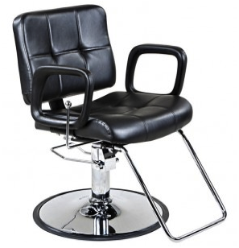
Notes:
So what could we have done? We could have set up the room with chairs that were flexible and that could have been independently adjusted by participants to suit their needs. We could have designed for the variability that we would expect.

Slide 21
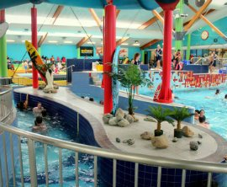
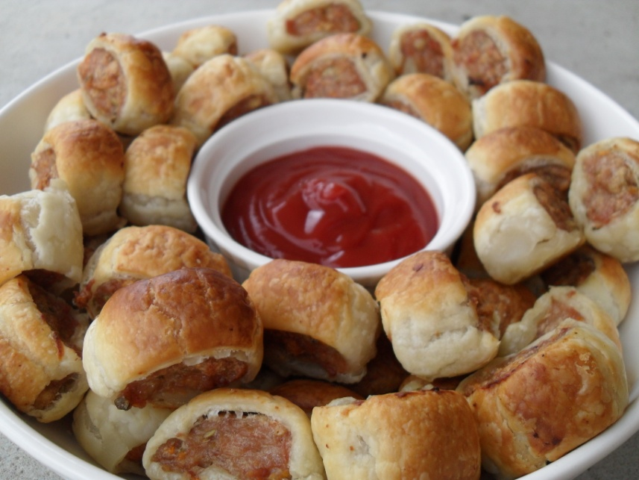
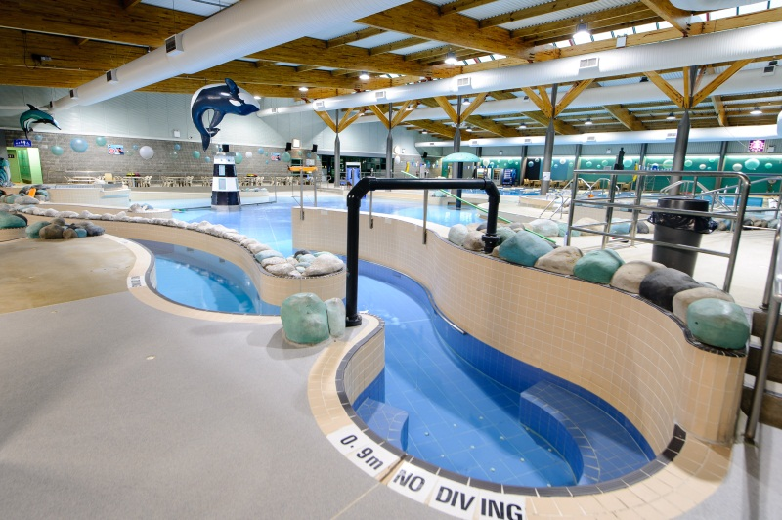
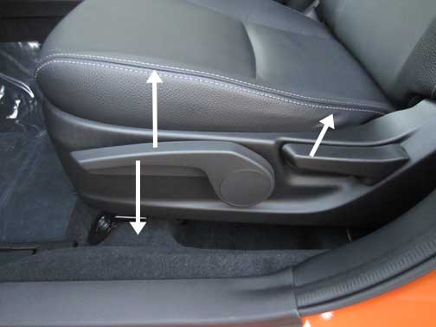
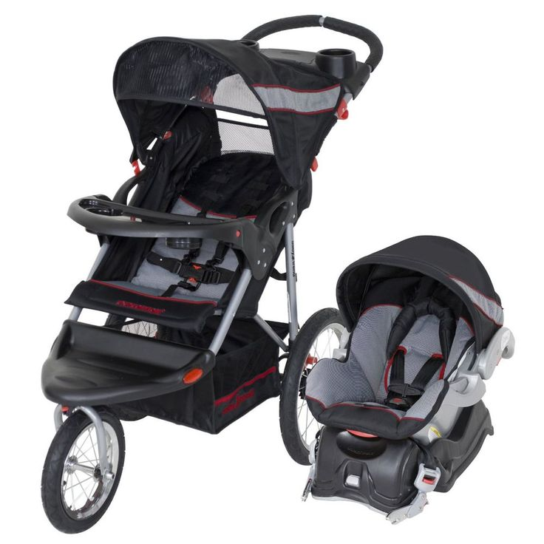
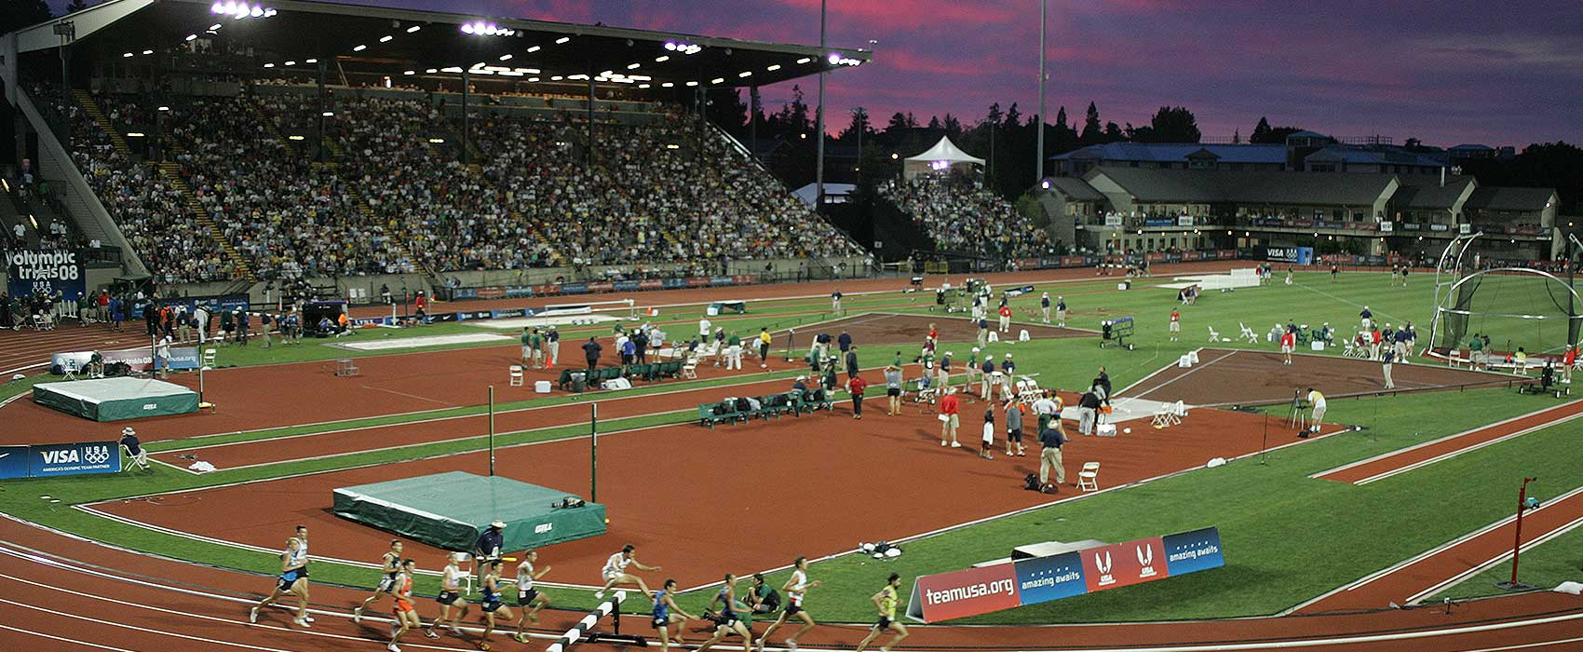
Notes:
Looking at the situations in which we expect, assume, are hard wired and design for variability
Plan for predictable variability from the outset
Creating courteous, respectful, inclusive environments for learning
We’ve thought about people before they come
We can plan for this without knowing who will be there
Vege – everyone eats anyway
It depends how you feel on the day and can change by the day or even during the day
Car – expect seat to be flexible and expect to be able to do it ourselves – be independent, without help

Slide 22
Universal Design for Learning
Source:
http://www.udlcenter.org/
Notes:
Universal Design for Learning looks at providing a range of options for students to create, learn and to share what they know.
As with the swimming pools and car seats, it’s about planning for variability from the outset.
Its about creating courteous, respectful, inclusive environments for learning
It’s about demonstrating that we’ve thought about students before they come
Point out that we did our mihi in two language and in visuals
Using the principles, we can plan for all students from the outset, by asking ourselves, how can we stimulate motivation, what variety of ways can we present the classroom content, and what options can we provide for students to express what they know?
Moving from learning with limits or barriers to what the CAST website now terms, “Until learning has no limits”.

Slide 23
UDL activity
Notes:
As our final activity for this session, we want you to design a community pool facility that everyone in your local community can access and use (assume money is no factor!)

Slide 24
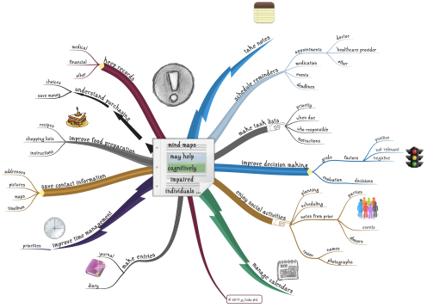
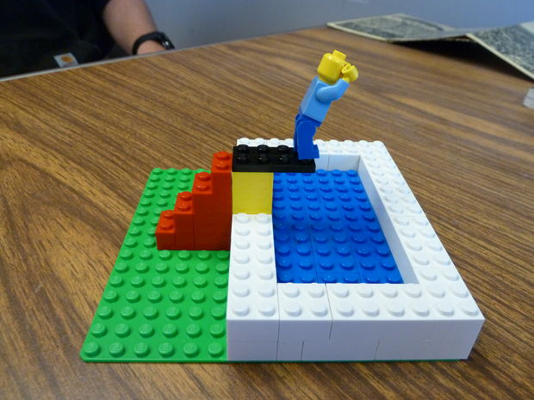
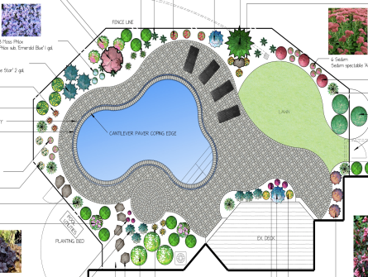
Activity: How do you consider and plan for variable needs?
Physical build
Mind map
Community consultation plan
Drawing plan
Notes:
The point of this activity is not to complete the activity because we only have a short amount of time.
The point of this activity is to get you thinking about how you plan for variable needs from the outset. You will have 5 minutes to organise your groups, 10 minutes to discuss who your pool facility needs to cater for and 15 minutes to develop your plan.
You have four options for how you wish to group yourselves:
Physical build using tools we provide
Draw a plan for your pool facility
Create a mind map of all the things your pool facility needs to include
Develop a consultation plan that covers all of the people you need to consult and what about
Report back on your experience of the process of planning for variablity.

Slide 25
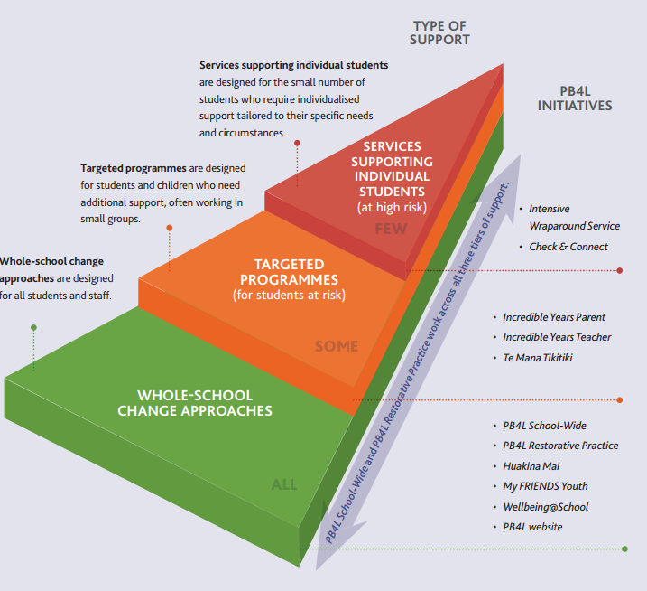
The relationship between UDL and differentiation
(Positive Behaviour for Learning – three tiers of support)
Notes:
Designing the least restrictive environment for all students reduces the need for extensive differentiation. Students are able to independently customise the learning environment to meet many of their own needs. There will be individual students who benefit from further differentiation.
Tthe PB4L tiered approach to supports is a good illustration of how UDL and differentation relate to each other. UDL provides universal supports for all students (the green), and more targeted supports may benefit some students.

Slide 26
Is a PB4L school an inclusive school?
Yes!
No!
Maybe?
Depends...
Notes:
Given the discussions we’ve just had, show us a sign:
Do you think a PB4L school is automatically an inclusive school?
There are many commonalities between PB4L School-Wide and inclusion. Inclusion does not need to be an add-on. The activities and perspectives we’ve looked at today can all be woven naturally into your school-wide journey:
Look at whether your PB4L expectations reflect inclusive values
Use the tools we’ve given you to weave student voice into your PB4L work
Look at how Universal Design for Learning and planning for all learners can support student engagement, behaviour and learning.

Slide 27
The last word – Eli and Ivan

Slide 29
Mā te huruhuru te manu karere
With feathers a bird flies

